Slide 1
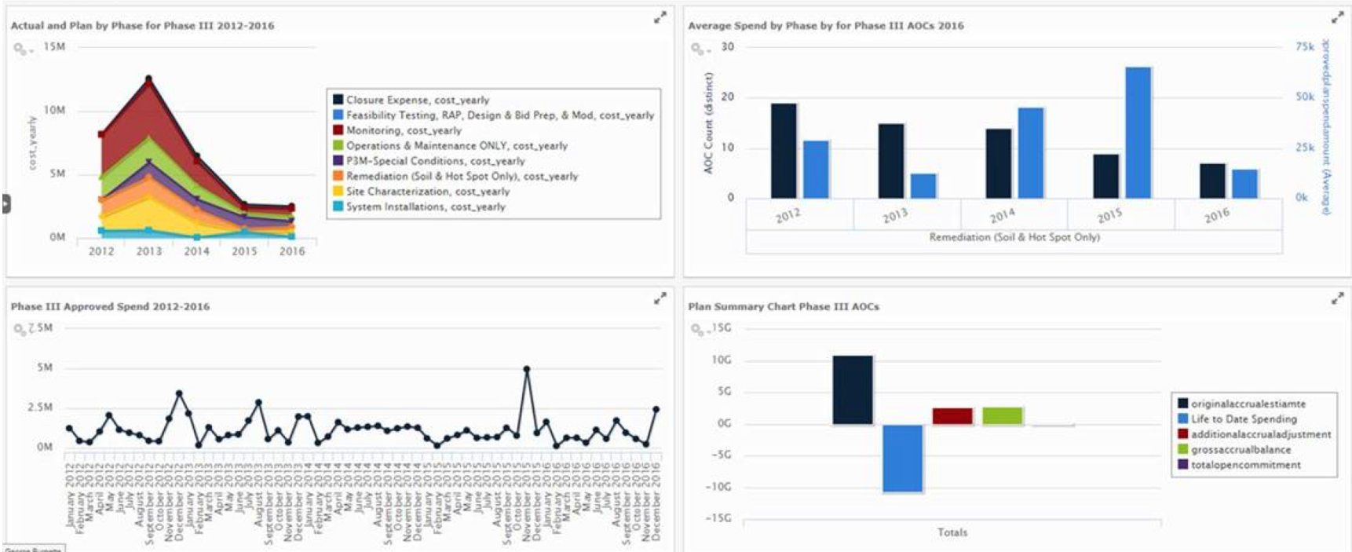
ENFOS Webinar
Remediation Insights
December 12, 2017

Slide 2

About Us
ENFOS is a cloud software platform that expertly manages all of the complexities of remediation and decommissioning - from the financial to the technical.

Slide 3
Agenda
Business Intelligence (BI) Overview
How BI is Delivered to Decision Makers
Examples:
  Monitoring Well Assets – Risk Assessment
  Groundwater Results – Portfolio Watch List
  Lifecycle Cost Forecasting – Accuracy Analysis
  Financial Performance Index – Algorithm Method
Questions and Answers

Slide 4


Speaker Background: Roger Well, CPG, PMP
Co-founder of ENFOS, Inc. (Oct 2000)
29 years of experience in the field
Author of recent white papers and presentations:
  Remediation Insights: What Your Data is Telling You
  The Case for the Enterprise Environmental Liability Management System
  Operational Excellence for Environmental Remediation Programs
M.B.A., Keller Chicago
M.S., Geology - University of Toledo
B.A., Geology - Monmouth College
Roger Well
Executive Vice President & COO
roger@enfos.com
Naperville, IL

Slide 5
Business Intelligence Overview

Slide 6

What is Business Intelligence?

Slide 7
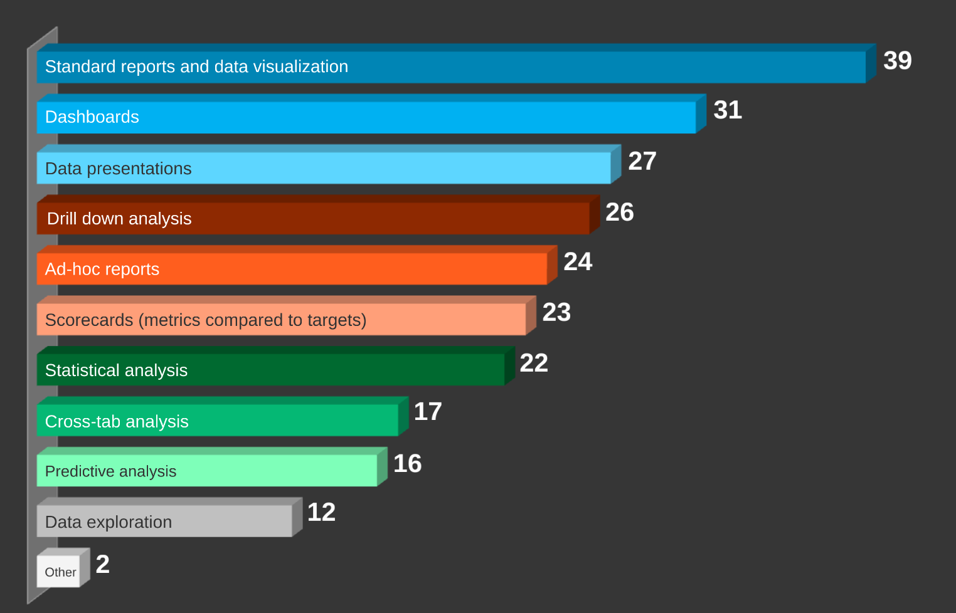
Business Intelligence Features

Slide 8
Example Dashboard

Slide 9
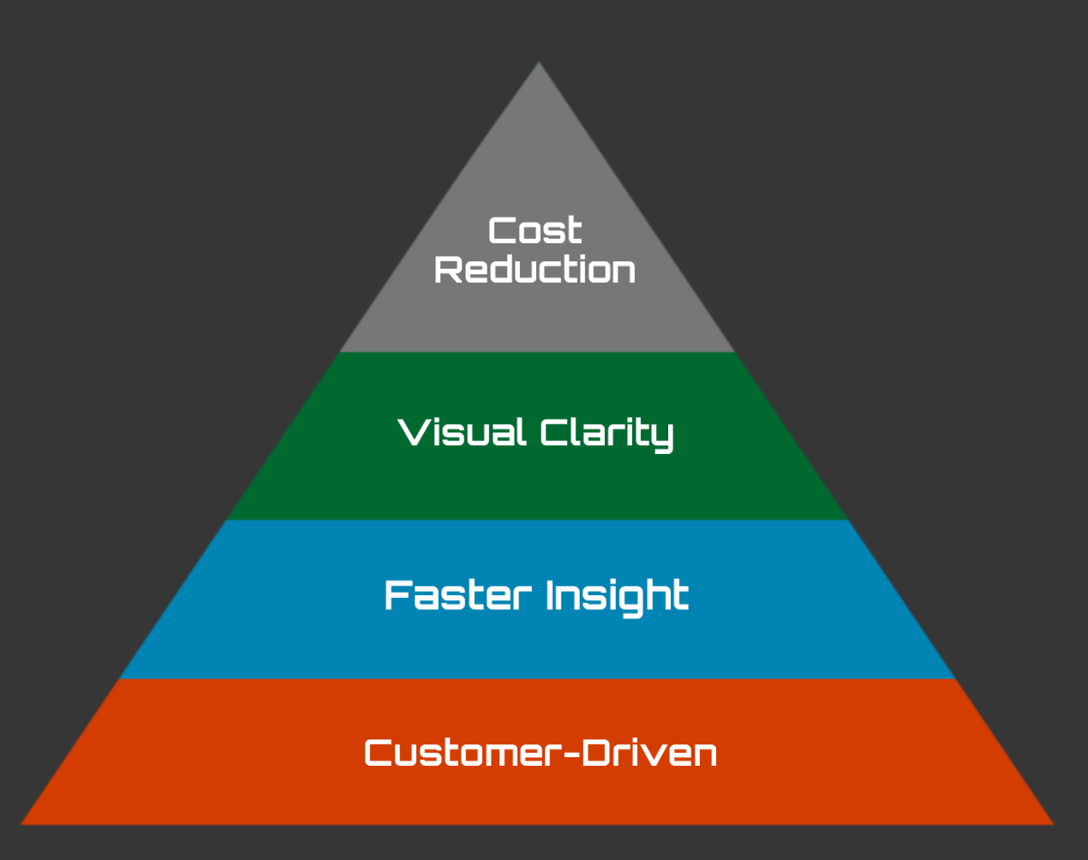
Business Intelligence Value Proposition

Slide 10
What View Do You Need In Your Role?
Hindsight
What happened?
Insight
Why did it happen?
Foresight
What is going to happen?

Slide 11
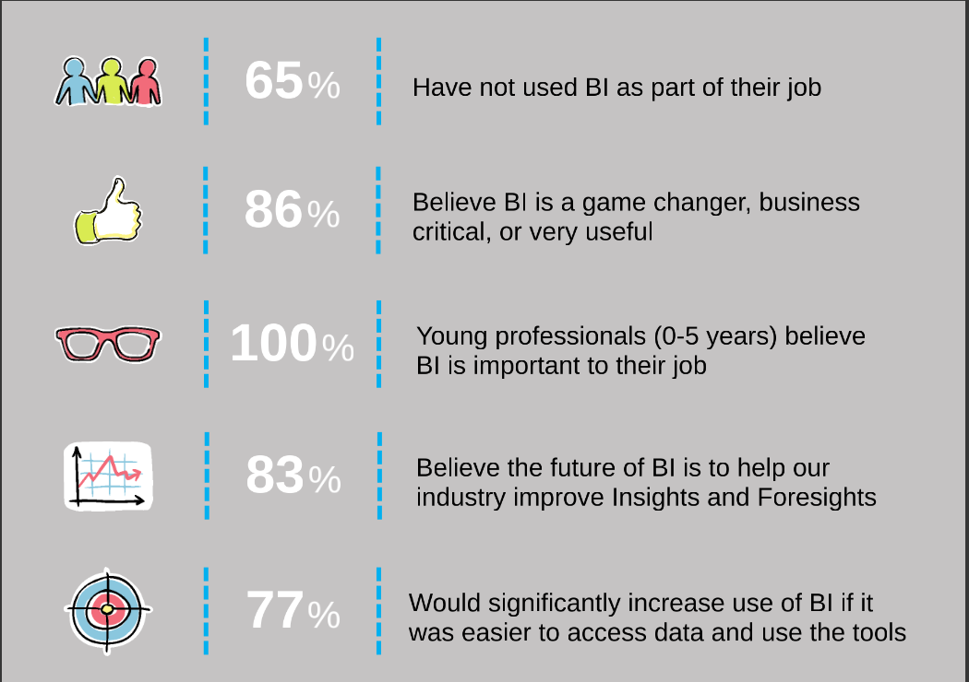
ENFOS Remediation BI Survey Results Summary

Slide 12
Business Intelligence Delivery Models

Slide 13
Approaches to Deliver BI to End Users
Spreadsheets and One-Off Analyses
General BI Applications such as Power BI, Tableau, and SpotFire connected to one or more data sources
Embedded BI within subject-matter applications such as ENFOS for environmental remediation management

Slide 14
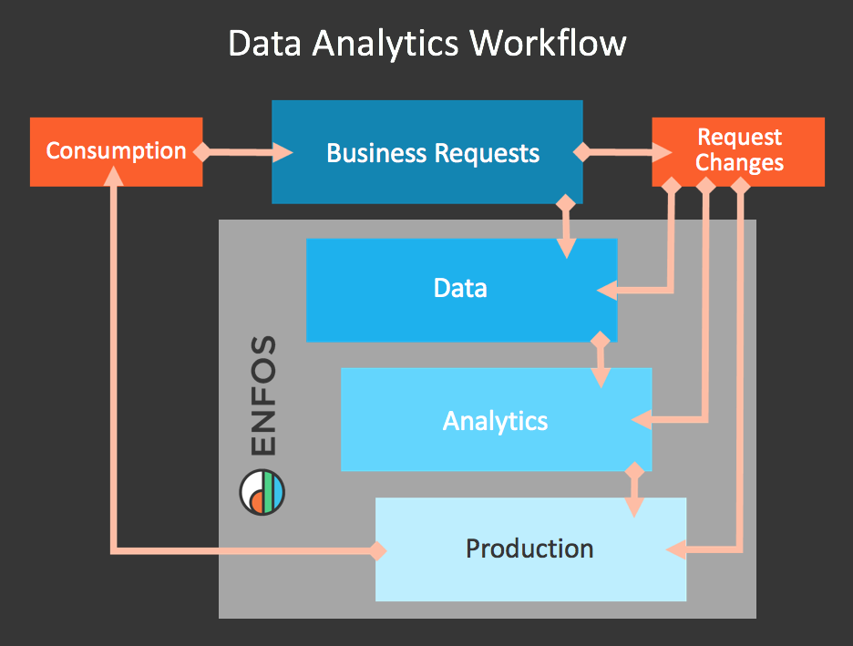
Embedded Business Intelligence

Slide 15
Business Intelligence Examples

Slide 16
Monitoring Well Assets
23,548
Monitoring Wells

Slide 17
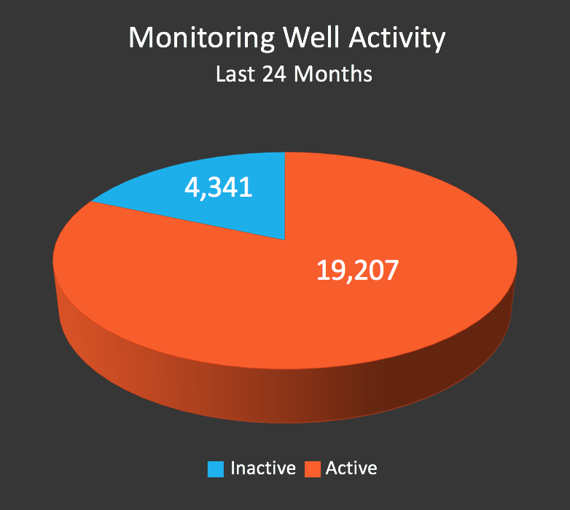
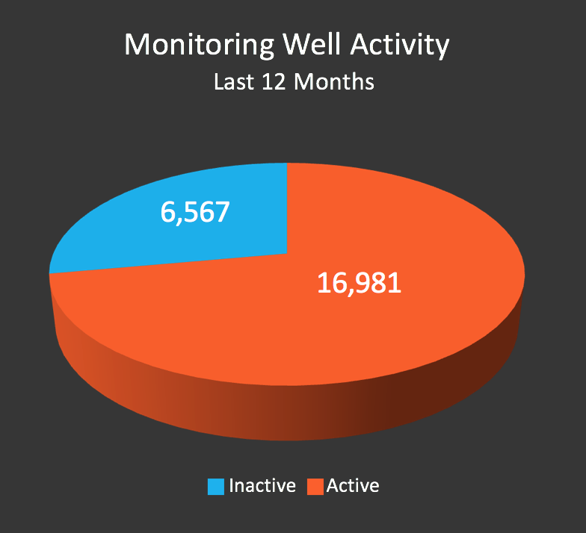
Logical Alternatives Using Data From
Sampling & Monitoring Events

Slide 18
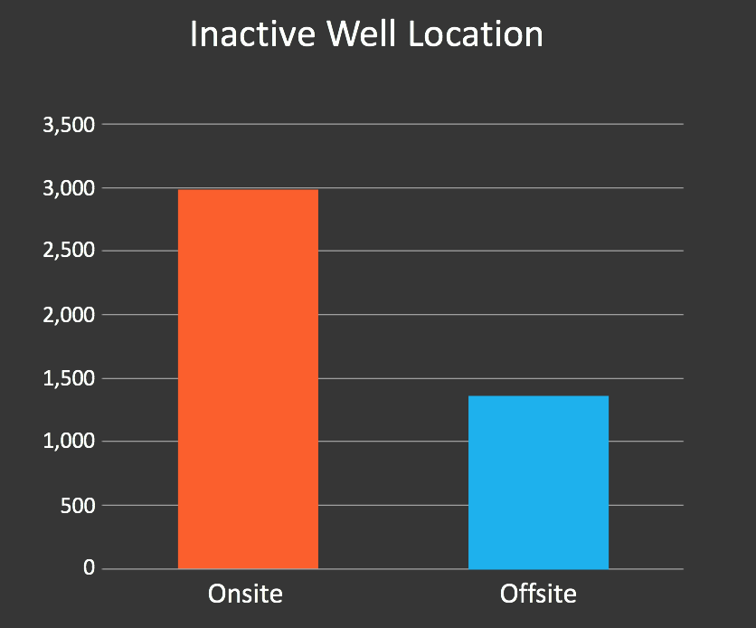
Second Tier Analysis on Inactive Well Location

Slide 19
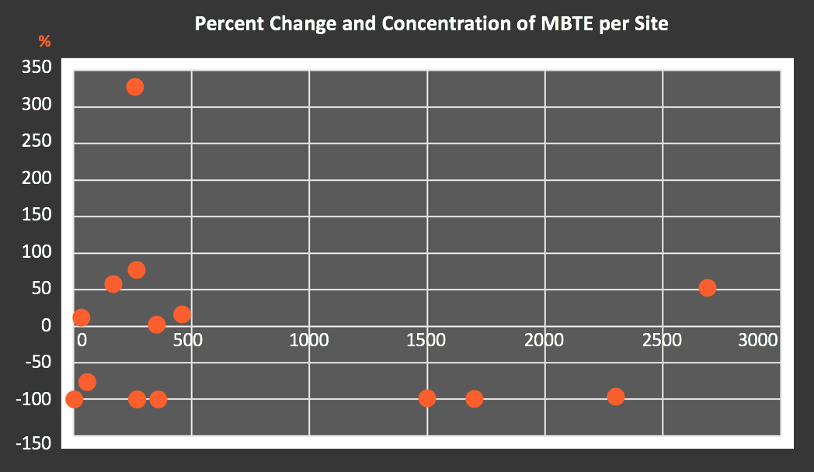
Groundwater Results – Portfolio Watch
Site 1
Site 2

Slide 20
Lifecycle Cost Forecasting – Accuracy (1)
30,000,000
25,000,000
20,000,000
15,000,000
10,000,000
5,000,000
0
2008
2009
2010
2011
2012
2013
2014
2015
2016

Slide 21
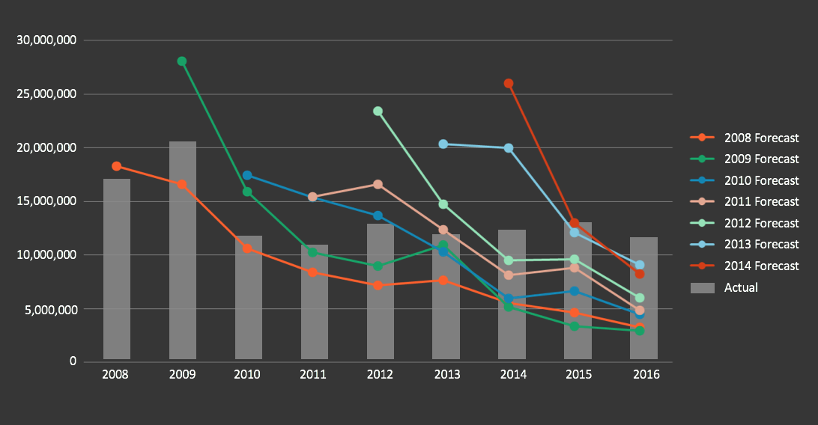
Lifecycle Cost Forecasting – Accuracy (2)

Slide 22
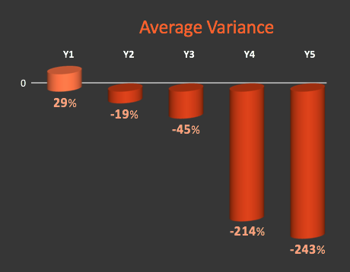
Lifecycle Cost Forecasting – Accuracy (3)

Slide 23
Financial Performance Index - Algorithm
Step 1
Cash Efficiency = (ETC₁ – ETC₂ / Spend)
Where:
ETC = Estimate to Complete (1 = Start of Period, 2 = End of Period)
Example:
CE = ($100,000 - $90,000) / $20,000 = 0.50 (or 50%)

Slide 24
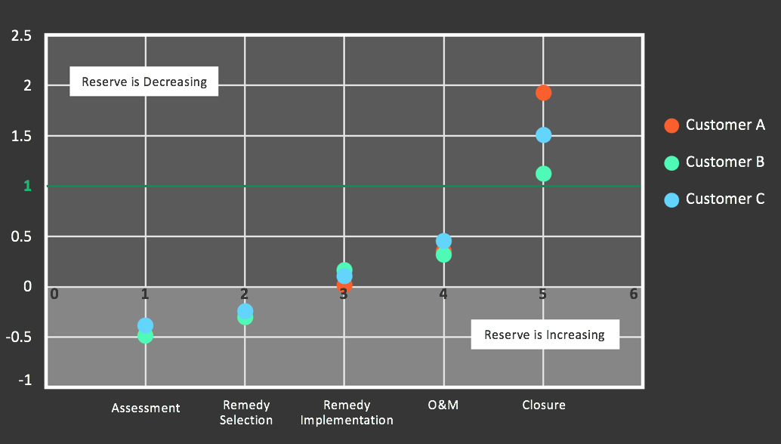
Cash Efficiency by Phase

Slide 25
Financial Performance - Algorithm
Step 2
Performance Adjusted ETC = ETC / CE
Step 3
Performance Index = ETC / Per. Adj. ETC

Slide 26
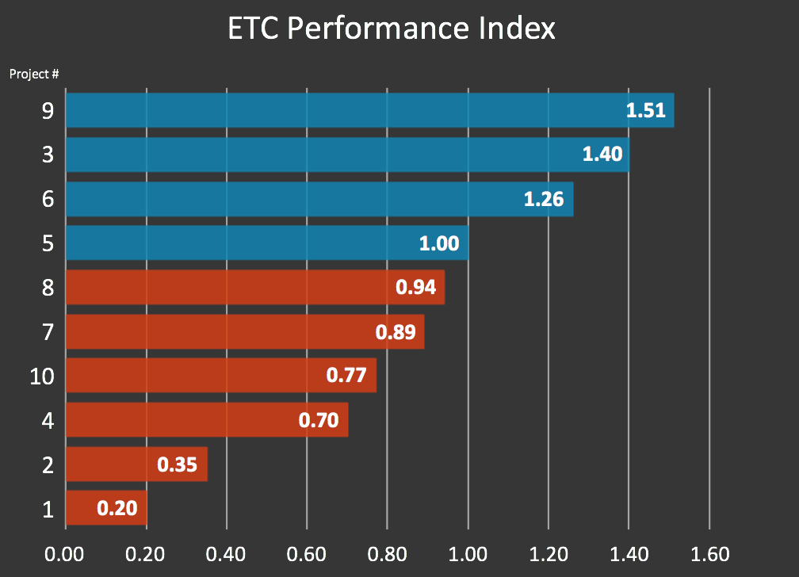
Performance Ranking Using the Index

Slide 27
Questions & Answers

Slide 28

Thank you for attending!
For follow-up, please contact:
Michael Douglas
(630) 689-0220 x15
michael@enfos.com

