Slide 1
ENFOS Webinar:
5 Essential Information Management Trends for the Remediation Industry
August 22nd, 2018

Slide 2

About Us
ENFOS is a cloud software platform that expertly manages all of the complexities of remediation and decommissioning - from the financial to the technical.

Slide 3
























Our Customers

Slide 4


Speaker Background: Roger Well, CPG, PMP
Co-founder of ENFOS, Inc. and EVP/COO
30+ years of experience in the field
Author of recent white papers and presentations:
  Remediation Insights: What Your Data is Telling You
  The Case for the Enterprise Environmental Liability Management System
  Operational Excellence for Environmental Remediation Programs
M.B.A., Keller Chicago
M.S., Geology - University of Toledo
B.A., Geology - Monmouth College
Roger Well
Executive Vice President & COO
roger@enfos.com
Naperville, IL

Slide 5
Agenda
Technology and the Remediation Industry
5 Essential Trends
  Institutionalizing Knowledge Management
  Convergence of Technologies
  Data “Ownership vs Possession”
  Hybridization of Business Process Management
  Rapid Emergence of Machine Learning
Q & A

Slide 6
Technology and the Remediation Industry

Slide 7




The 21st Century Enterprise
Enablers
Enterprise Technology
Cloud
Internet of Things
Business Process Automation
Mobile
BI & Analytics
Data Visualization
Drones
AI/Machine Learning
Augmented & Virtual Reality
Software as a Service
Changing nature & value of assets
subscribing to what you need, subject matter expertise, part of larger ecosystem, self-service
Data-as-an-asset, decision support, connected devices, lower IT footprint
‘’’
‘’’
Workforce of the Future
People Engagement
Expects automation, demands high-tech, remote workforce, collaboration
Personalization, co-creation, knowledge base, human networks, agility

Slide 8
Remediation Management is a Complex System
Complex Services / Long lifecycles
Thousands of transactions & documents
Complex regulatory environment
Outsourced business model
Complex accounting
DISPARATE SYSTEMS
IT
Environmental Regulations
Finance
Outside Legal
Real Estate
Liability Disclosure Regulations
CORPORATION
Consultants
HES / Remediation
Property Owners
Legal
Subcontractors
Labs
Community
Communications
Sites
Procurement
Notes:
ENFOS (Mike or Lacey)

Slide 9
Obstacles We Hear About…
The Remediation business function is a cost center not a profit center
The Industry developed it’s “core capabilities” before the dot-com bubble of the mid 1990’s (including how data is captured, processed, and acted upon)
Remediation is a mature industry being performed by mature organizations (not a good recipe for innovation)
Past “failed” technology initiatives and promises (they usually don’t scale)
Reluctance to change (human behavioral change is slow)
Risk vs. reward perceptions
Remediation gets “dragged” into using generic business applications not fit for purpose
Leadership lacks experience with tech-driven business transformation

Slide 10
But…Consider This
Those slow to adopt new technology often benefit the most from it
The on-going technology waves are only growing stronger
The younger workforce demands it
There is a strong business case and ROI

Slide 11
Knowledge Management

Slide 12
Definition
Knowledge management is the process and capturing, distributing, and effectively using knowledge.
Davenport, 1994

Slide 13



Knowledge Management Trilogy
TECHNOLOGY
Acquire the right technology to address your specific issues
PEOPLE
PROCESS
Empower individuals to be successful with technology
Enable organizational excellence through process

Slide 14
Structured vs. Unstructured Data
80%
of the world’s data is unstructured
Gartner, 2017

Slide 15







Curation of Content by Risk Category
Remedy Performance
Human Health
Ecological
Regulatory
Economic
Project & Contract
Performance
Legal & Audit
Political & Social
ITRC, 2011

Slide 16
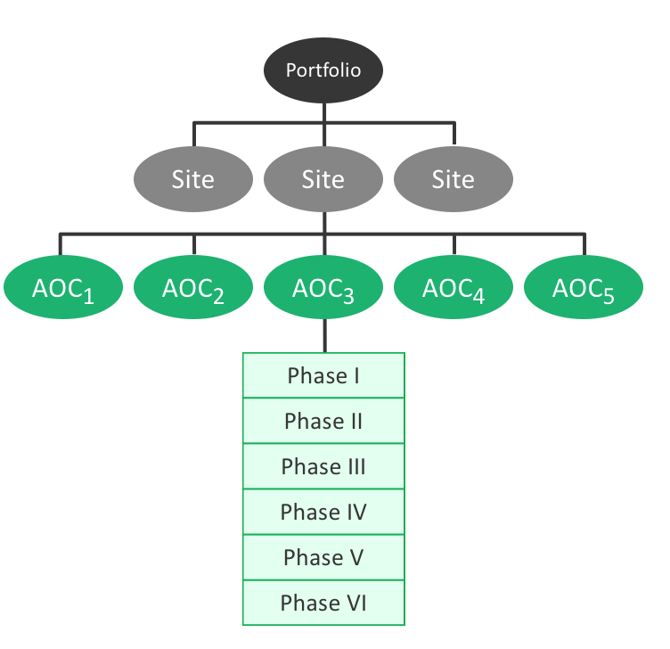
Enterprise System Taxonomy for Sites/Projects
Notes:
ENFOS (Mike or Lacey)

Slide 17
Knowledge Management Features
Enterprise content/document management
Consolidation of indexed content
The standard “keyword” search approach for tags, titles, file meta-data, content, and classification
Human association (Expert locating)
Data repurposing across multiple functions
Drill down for multidimensional exploration
Subject matter expert systems like ENFOS
  Pre-defined structured processes and data management (end-to-end)
  Remediation portfolio based taxonomy navigation
  Folder/Tree traversal structures
  Map visual searches
  Notes, website links, graphic illustrations
  Embedded business intelligence tool

Slide 18
Convergence of Technologies

Slide 19
Definition
An ecosystem or technology platform that has a deep integration of relevant activities, tools, and knowledge needed by stakeholders to achieve a common goal.

Slide 20
The Opposite of Convergence
Typical Customer Data Silos
Site & Project Tracking
Content Mgmt
Document Mgmt
Notes
Agreements
Project Mgmt
Risk Mgmt
Purchase
To Pay
Planning & Budgeting
Accounting for Environmental Liabilities
Accounting for Asset Retirement Obligations
Spend Mgmt
Compliance Management
Supplier Mgmt
Environmental Data Management
Reporting & Analytics
Dashboards
Mobile Devices
Engineering & Institutional
Controls
Maps

Slide 21

Subject Matter Expert Software for Remediation
COMPLEX RISKS
COMPLEX SERVICES
COMPLEX ACCOUNTING
“Remediation business functions are being empowered by the trend of purpose-built enterprise software that compliments the ERP system”

Slide 22
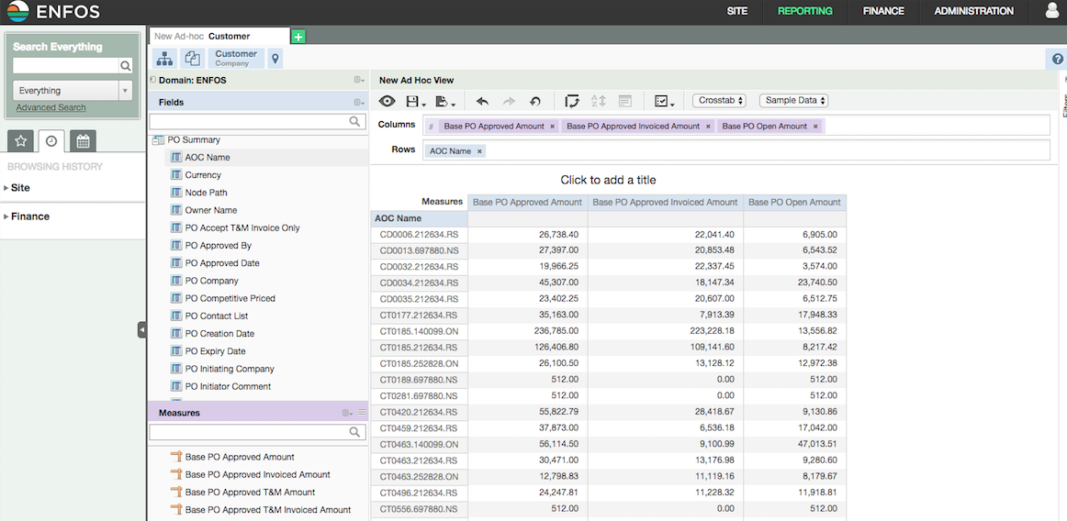
Embedded BI/Analytics

Slide 23
Customer Designed Dashboards

Slide 24
Ownership vs Possession

Slide 25











Data Architecture Models
Decentralized
Hybrid
Enterprise
Central Data Repository
Administrators
Responsible Party
Laboratory
Consultants
Contractors
Internal Customers
Other Specialists

Slide 26
Considerations
Data ownership & stewardship falls under data governance
Enterprise technologies are “game changers” in this space
  Uniform data design and structures
  Establish end-to-end standards (capture-maintenance-synthesis-usage-publication-archival-purging)
  Enforce data quality and completeness (error proofing)
  Analytics ready data (with decentralized/hybrid models, data analysts spend 80% of their time preparing data and only 20% analyzing it)
Data access, privacy, security, and business continuity
Data possession reduces the impact of employee turnover and supplier switching (consider the aging workforce)

Slide 27
Hybridization of Business Process Management

Slide 28
Definition
Smartly designed technology finds the connections between separate processes, joins them, and delivers a unified “super process” with real-time feedback to the user.

Slide 29
Environmental Reserve & Spend Management
Finance “Super” Process with Reserve Accounting
Planning & Budgeting
(Reserve Mgmt)
Vendor Proposals
Purchases
Invoices & Recovery
2
4
3
5
Commitments can’t Exceed Plan Balance
Spend can’t Exceed Commitments
1
LEVEL 1 – “Phase”
LEVEL 2 (optional) – “Activity”
LEVEL 3 (optional) – “Element”
LEVEL 4 (optional) – “Component”
WORK BREAKDOWN STRUCTURE
Common thread across all processes
Reserve Balance $250,750
Open Commitments $175,400
Available to Commit $75,350
Automated Reserve Accounting
Notes:
Roger

Slide 30
“Project Management Enhanced” Purchase to Pay
Merged project management and transactional activities for project-based work, that due to it’s nature of being outsourced, requires integration with the buyers P2P system.
Project Management Elements
P2P Elements
Project Initiation
Scope Management
Cost Management
Schedule Management
Deliverables / Milestones
Gantt Charts
Earned Value Calculation
Project Close Out
Vendor Master & Catalogs
Delegations of Authority
Chart of Accounts (Codes)
Work Breakdown Structures
Request for Proposals
Vendor Proposals
Requisitions & Purchase Orders
Receipt of Services
Invoices

Slide 31
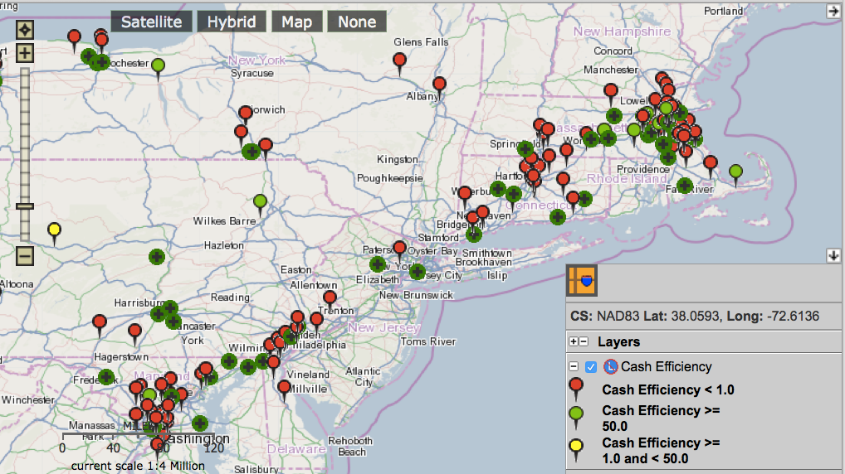
Financial Ratio Analysis in combination with Data Visualization: Geo-Accounting

Slide 32
Rapid Emergence of Machine Learning

Slide 33
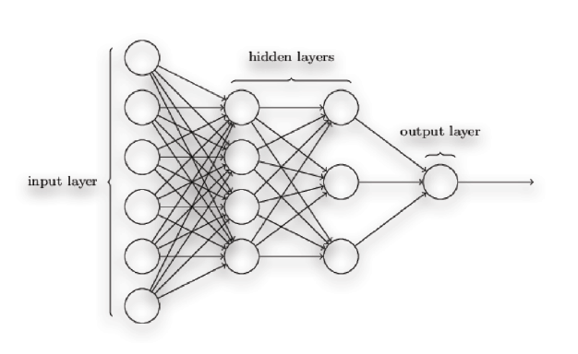
Definition
Computers can “learn” from data without being explicitly programmed through automated analytical model building.

Slide 34
ENFOS and ML
ENFOS is working with a team of MIT computer scientists
Using ”Supervised Learning” techniques to map ‘x to y’
  Input to Output
  Actual Spend to Forecasted Spend
  Remaining Budget to Potential Cost Overrun
  Reserve Balance to Projected Reserve Replenishment
  Documents to the Key Data locked in them
  Attributes (Location/Hydrogeology/Contaminants) to Risks
  Conceptual Site Model to Remedy Selection

Slide 35
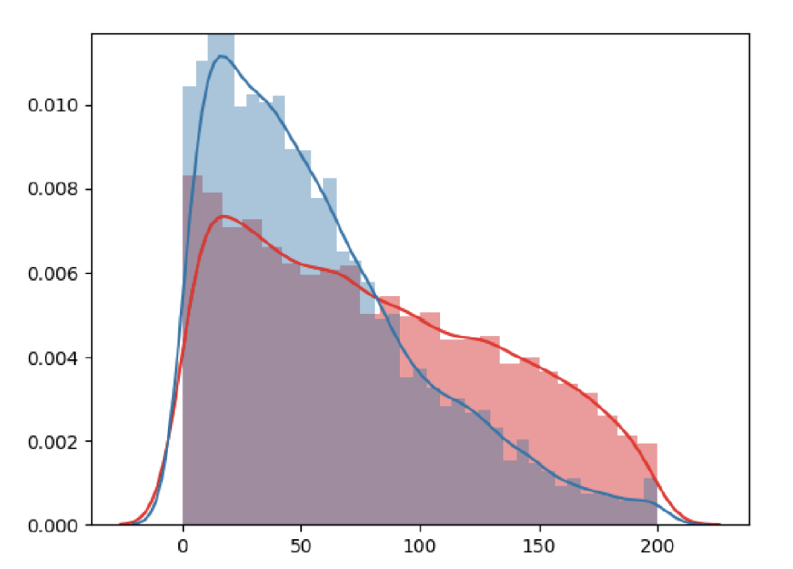
Remediation Lifecycle Cost Forecasting Results
Density
Blue: ML model output vs Actual
Red: Original Estimate vs Actual
SMAPE Error %
In our initial study, ML produced 62% more accurate forecasts of costs on a remediation portfolio of several hundred projects

Slide 36
Structuring a ‘Highly Unstructured’ Data Source
Documents make up a large part of the content mix in Remediation, particularly the historical record
ML goes beyond “OCR and Indexing” to deeper levels of classification, understanding, interpretation, and text analytics (data extraction or ‘text to data’)
Provides the platform for natural language queries, predictions, risk events, and recommendations
Project matching:
  Matches your Project to others with similar attributes (type, size, location, complexity, objectives, timing, conceptual site model, risk assessment)
  SME / Consultant selection
  Remedy selection
  Financial modeling

Slide 37
Constructing the CSM from ‘Text to Data’
#####
# Detected 'Statistics' (numbers present)
######
groundwater flow -- is --> convergent southeast at gradients of 0.082 ft. respectively
localized groundwater flow -- is --> convergent southeast at gradients of 0.082 ft.
volatile constituents -- detected in --> MW-2R
Warm Spring Run -- is --> perennial stream
soil -- is --> primarily clay with weathered shale partings
Bedrock -- is comprised of --> weathered shale
potential constituent migration routes -- include --> Soil Leaching of constituents from total soil
potential constituent migration routes -- include --> Soil Leaching from soil to groundwater
reasonable potential exposure pathways -- have --> As part of exposure pathway analysis have assessed
resident -- is current and future receptor --> that resides in residence located on western side of site
resident -- is current receptor --> that resides in residence located on western side
site-related volatile constituents -- retained as --> vapor intrusion COC
water samples -- collected from --> sump located basement
on-site -- will --> will addressed with institutional control

Slide 38
Questions & Answers

Slide 39

Thank you for attending!
For follow-up, please contact:
Michael Douglas
(630) 689-0220 x15
michael@enfos.com

Slide 40


